Slide 1
2019-20 AGASD Budget Review
Mr. Andy Musiolowski
June 5, 2019

Slide 2
2019-20 AGASD Budget Review
Dear Board Members:
I want to personally thank you for adopting the proposed budget at our last board meeting on May 15, 2019. Act 1 guidelines state that our school district’s deadline to adopt our 2019-20 proposed budget was May 31, 2019. Our deadline to adopt the 2019-20 final budget is June 30, 2019.
The only limitation placed upon a board of school directors in adopting the annual budget is that the total amount of the budget shall not exceed the amount of funds, including the proposed annual tax levy and state appropriation, available for school purposes in that district. In other words, a public school district is required to adopt a balanced budget.
Only governing board members and officers hold a fiduciary responsibility. This is the fundamental legal, or statutory, duty of board members. “Fiduciary” is an old English word from the Latin for “faith” and “trust.” It means as a board member you are someone who looks after the business and affairs of someone else, our school district, Albert Gallatin Area.
Board members are the fiduciaries who steer the district towards a sustainable future by making sound financial management decisions, as well as by making sure the district has adequate resources to advance its mission. School board members are public officials entrusted with governing a district’s public schools. The role of the school board is to ensure that school districts are responsive to the values, beliefs and priorities of their community.
Even though the budget is an annual estimate and a roadmap for the fiscal year, those values, beliefs and priorities are influenced by the budget.
That being said, let’s proceed with the 2019-20 General Operating Budget!

Slide 3
Student Enrollment
Student Enrollment
 |  |  |  | Cumulative | % Change
Year | Enrollment | Change | % Change | Change | from 07-08
2008-2009 | 3,785 | -41 | -1.1% | -41 | -1.1%
2009-2010 | 3,677 | -108 | -2.9% | -149 | -3.9%
2010-2011 | 3,596 | -81 | -2.2% | -230 | -6.0%
2011-2012 | 3,575 | -21 | -0.6% | -251 | -6.6%
2012-2013 | 3,531 | -44 | -1.2% | -295 | -7.7%
2013-2014 | 3,521 | -10 | -0.3% | -305 | -8.0%
2014-2015 | 3,435 | -86 | -2.4% | -391 | -10.2%
2015-2016 | 3,458 | 23 | 0.7% | -368 | -9.6%
2016-2017 | 3,413 | -45 | -1.3% | -413 | -10.8%
2017-2018 | 3,299 | -114 | -3.3% | -527 | -13.8%
2018-2019 | 3,313 | 14 | 0.4% | -513 | -13.6%

Slide 4
Student Enrollment
Student enrollment has decreased from 3,785 in 2008-09 to 3,313 in 2018-19 or a 14.3% decrease. In all but two years out of the last ten we had a decrease. Total decline in enrollment is 472 students over the last ten years.
Source: Pennsylvania Department of Education
Data & Statistics/Enrollment Reports & Projections

Slide 5
Special Education
Year | AFR Expenditures | AFR Subsidy | Net Cost | % Expend. Covered
 | 1200 | 7271 |  | By Subsidy
2007-2008 | 4,878,981 | 2,836,573 | 2,042,408 | 58.1%
2008-2009 | 5,199,079 | 2,803,519 | 2,395,560 | 53.9%
2009-2010 | 5,785,745 | 2,845,385 | 2,940,360 | 49.2%
2010-2011 | 5,939,726 | 2,824,452 | 3,115,274 | 47.6%
2011-2012 | 6,111,434 | 2,957,569 | 3,153,865 | 48.4%
2012-2013 | 6,223,755 | 2,893,783 | 3,329,972 | 46.5%
2013-2014 | 6,264,688 | 2,883,723 | 3,380,965 | 46.0%
2014-2015 | 6,908,766 | 2,878,512 | 4,030,254 | 41.7%
2015-2016 | 7,166,062 | 2,944,265 | 4,221,797 | 41.1%
2016-2017 | 7,220,025 | 2,979,664 | 4,240,361 | 41.3%
2017-2018 | 7,668,730 | 3,023,758 | 4,644,972 | 39.4%
Source: PDE
School Finances/Finances/Summaries of AFR Data
AFR Data Detailed
Expenditure Detail and State Revenue

Slide 6
Special Education
Our special education expenditures have increased from $4,878,981 to $7,668,730 in the last ten years by $2,789,749 or 57.2%. Subsidy has only increased $187,185 during the same time period. Expenditures covered by subsidy have decreased from 58.1% to 39.4%. When I started in schools, the state basically covered all special education expenditures under a formula called “excess cost.” How times have changed! A fair funding formula that properly accounts for the added costs required to educate our special education students would drive more money out to districts like ours, which would help us avoid financial hardships. Pennsylvania basically does not use an education funding formula that distributes state education dollars accurately and fairly. Over 20% of the District’s student population receives special education services.

Slide 7
Tuition expenditures
Year | Other LEAS | Cyber Charter | Non-Public | Fayette CTI | APS, PA Chartered | Total
 | 561 | 562 | 563 | 564 | 567
2007-2008 | 94,752 | 708,081 | 595,512 | 719,108 | 80,458 | 2,197,911
2008-2009 | 8,663 | 672,878 | 841,953 | 1,169,397 | 100,655 | 2,793,546
2009-2010 | 1,203 | 1,026,770 | 977,687 | 1,170,273 | 95,976 | 3,271,909
2010-2011 | 696 | 794,073 | 1,024,623 | 1,089,806 | 65,628 | 2,974,826
2011-2012 | 24,995 | 740,922 | 1,007,937 | 1,083,331 | 68,857 | 2,926,042
2012-2013 | 25,740 | 763,529 | 940,947 | 1,237,813 | 107,353 | 3,109,177
2013-2014 | 43,306 | 801,834 | 960,423 | 1,279,616 | 110,823 | 3,274,920
2014-2015 | 33,034 | 810,558 | 967,059 | 1,378,380 | 145,746 | 3,340,542
2015-2016 | 28,227 | 1,053,011 | 998,192 | 1,533,681 | 178,795 | 3,793,076
2016-2017 | 62,010 | 880,086 | 650,396 | 1,639,679 | 169,319 | 3,401,490
2017-2018 | 24,988 | 1,139,290 | 790,156 | 1,705,114 | 130,202 | 3,789,750

Slide 8
Tuition expenditures
Source: PDE
Teachers & Administrators/School Finance/Finances
Summary of AFR Data/AFR Data Detailed
Expenditures/Tuition Schedule

Slide 9
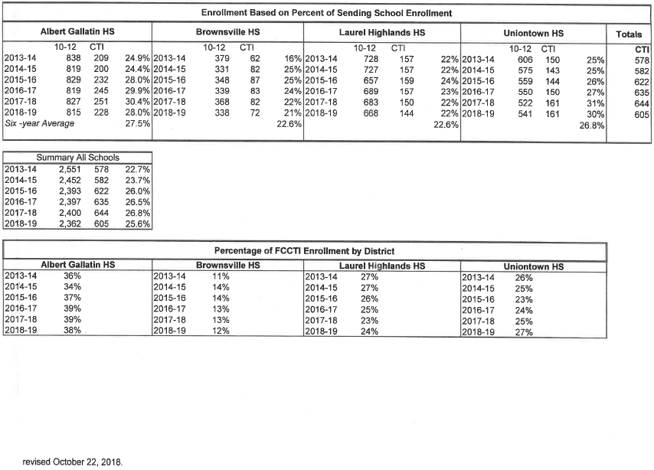
Tuition expenditures

Slide 10
Tuition expenditures
Tuition expenditures have increased by $1,591,839 or 72.4% over ten years. The largest two components have been the Fayette CTI and Cyber Charter schools. The Fayette CTI tuition costs have increased almost $1 million or 137%, while Charter Schools have increased $431,209 or 61%. Our enrollment at FCCTI has only increased by 9% for the last five years and our percentage of total enrollment has remained consistently in the 36-39% range, so our utilization has not caused the tuition cost increase nearly as much as economics. FCCTI costs have increased substantially.
Charter schools are basically publicly funded private schools. Some reasons for not using public money to fund these schools is as follows:
Freedom from regulations and oversight through public governance has resulted in patterns of waste and fraud.
Bleed money from the public school system, which results in rather a lesser education for public school students or an extra burden on taxpayers.
Eliminate democracy from school governance, and parents feel this lack of voice in disadvantaged communities.
Loose laws around conflict of interest combined with lack of transparency regarding spending have provided fertile ground for profiteers.
The District’s cost has nothing to do with the actual costs for charter schools. The result is an uncontrollable cost imposed on the home district! This is a state mandate over which school districts have no cost control.

Slide 11
Market value vs. assessed value
Year | Market Value | Change | % Change | Assessed Value | Change | % Change
2007-2008 | 530,736,868 |  |  | 587,246,660
2008-2009 | 585,406,932 | 54,670,064 | 10.3% | 596,795,460 | 9,548,800 | 1.6%
2009-2010 | 597,708,808 | 12,301,876 | 2.1% | 606,836,400 | 10,040,940 | 1.7%
2010-2011 | 645,674,190 | 47,965,382 | 8.0% | 611,846,320 | 5,009,920 | 0.8%
2011-2012 | 660,546,660 | 14,872,470 | 2.3% | 622,211,860 | 10,365,540 | 1.7%
2012-2013 | 809,102,244 | 148,555,584 | 22.5% | 663,352,670 | 41,140,810 | 6.6%
2013-2014 | 818,865,179 | 9,762,935 | 1.2% | 671,813,170 | 8,460,500 | 1.3%
2014-2015 | 905,879,305 | 87,014,126 | 10.6% | 700,078,710 | 28,265,540 | 4.2%
2015-2016 | 914,431,042 | 8,551,737 | 0.9% | 706,536,620 | 6,457,910 | 0.9%
2016-2017 | 931,397,198 | 16,966,156 | 1.9% | 686,526,400 | -20,010,220 | -2.8%
2017-2018 | 935,513,522 | 4,116,324 | 0.4% | 689,127,970 | 2,601,570 | 0.4%
Source: Department of Community and Economic Development
State Tax Equalization Board, Tax Equalization Division
STEB Reports
Most recent data available as of 4/13/2019

Slide 12
Market value vs. assessed value
While actual market value has grown over 76% in the last decade, assessed value has only increased by 17%. Unfortunately, assessed value determines our tax base for real estate taxes. Only a countywide reassessment can rectify this imbalance. The last countywide reassessment was in 2001, our base year for assessed valuation. The State uses a common level ratio that compares actual sale prices to stated county assessments across Pennsylvania. The State Tax Equalization Board has determined that as of July 1, 2018, Fayette County’s common level ratio is 1.40. This means the County’s stated assessment of 100% of market value is actually only 71% of market value.

Slide 13
District aid ratios
Year | MV/PI Aid Ratio | MV Aid Ratio | PI Aid Ratio
2007-2008 | 0.7873 | 0.8136 | 0.7480
2008-2009 | 0.7803 | 0.8083 | 0.7385
2009-2010 | 0.7829 | 0.8088 | 0.7444
2010-2011 | 0.7799 | 0.8114 | 0.7328
2011-2012 | 0.7735 | 0.8072 | 0.7231
2012-2013 | 0.7748 | 0.8048 | 0.7300
2013-2014 | 0.7737 | 0.8065 | 0.7245
2014-2015 | 0.7491 | 0.7610 | 0.7313
2015-2016 | 0.7442 | 0.7582 | 0.7233
2016-2017 | 0.7305 | 0.7379 | 0.7195
2017-2018 | 0.7321 | 0.7326 | 0.7317
2018-2019 | 0.7353 | 0.7315 | 0.7410
Source: Pennsylvania Department of Education
Teachers & Administrators / School Finances / Finances Financial Data Elements/ Aid Ratios

Slide 14
District aid ratios
Aid ratio (AR) is the general term for the following three numerical values. Various state subsidies use aid ratios in their calculations. The smaller the aid ratio the wealthier a district. Our aid ratio remains one of the highest in the state.
MV/PI (Market Value/Personal Income) Aid Ratio is the Commonwealth’s method of determining the combined market value and income wealth for each pupil. Basically, it represents the relative wealth (market value and income), in relation to the state average, for each pupil in a school district.
MV (Market Value) Aid Ratio is the sales value of taxable real estate as certified by the State Tax Equalization Board. The 2016 market value is used in the calculation of the market value aid ratio for payable year 2018-19.
PI (Personal Income) Aid Ratio reflects personal income for residents of our school district, excluding out-of-state income, as reported on the PA-40 income tax return.
Data is certified to PDE by the PA Department of Revenue.
The MV/PI and MV Aid Ratios have decreased slightly indicating increased wealth, but due to our 2001 base assessment year, only our state ratios have increased, not our assessed valuation that determines what our real estate taxes actually generate in income. PI has remained fairly constant, actually indicating a decrease in wealth due to inflation.

Slide 15
Expenditures by object - $55,819,444
100 - Salaries – 38.15% - $21,295,539
200 - Benefits – 27.89% - $15,566,267
300 - Purchased Professional & Technical Services – 7.10% - $3,962,078
400 - Purchased Property Services – 1.41% - 786,905
500 - Other Purchased Services (Transportation/Tuition) - 13.87% - $7,742,119
600 - Supplies – 3.59% - $2,004,660
700 - Property (Equipment) – 0.42% - $235,700
800 - Other Objects (Interest/Dues/Fees) – 1.70% - $946,176
900 - Other (Debt Service Principal/Food Service Transfer) 5.88% - $3,280,000

Slide 16
Expenditures

Slide 17
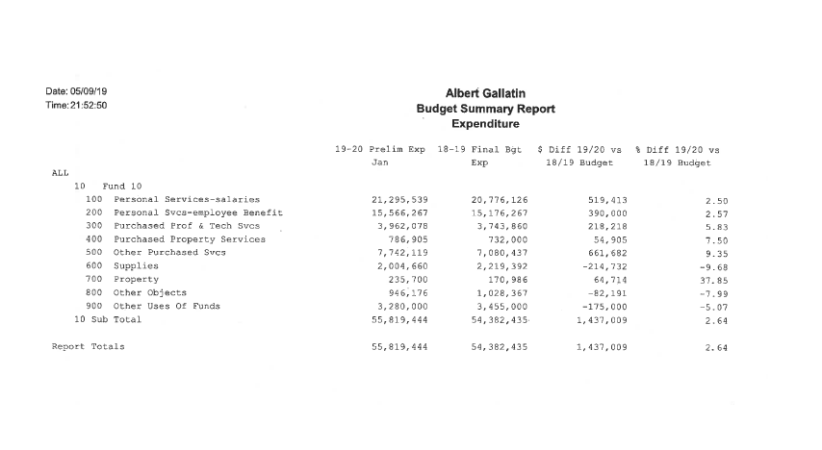
Expenditures

Slide 18
Expenditures by function - $55,819,444
        1100 – Regular Programs - $22,251,622
1200 – Special Programs - $8,413,150
1300 – Vocational Education - $1,825,000
1400 – Other Instructional Programs Elem/Sec - $497,039
1500 – Nonpublic School Programs - $10,000
1000 – Total Instruction $32,996,811 – 59.1%
2100 – Pupil Personnel – $1,784,011
2200 – Instructional Staff - $716,548
2300 – Administration – $3,901,085
2400 – Pupil Health – $446,870
2500 – Business Office - $625,518
2600 – Operation & Plant - $6,190,896
2700 – Transportation - $3,317,167
2800 – Central Support - $688,323
2900 – Other Support Services - $27,800
2000 – Total Support Services - $17,698,218 – 31.7%
3200 – Student Activities - $959,976
3300 – Community Services - $29,891
3000 – Total Noninstructional Services - $989,867 – 1.8%
5100 – Debt Service - $3,944,548
5200 – Fund Transfers - $190,000
5000 – Total Other Expenditure - $4,134,548 – 7.4%

Slide 19
Expenditures

Slide 20
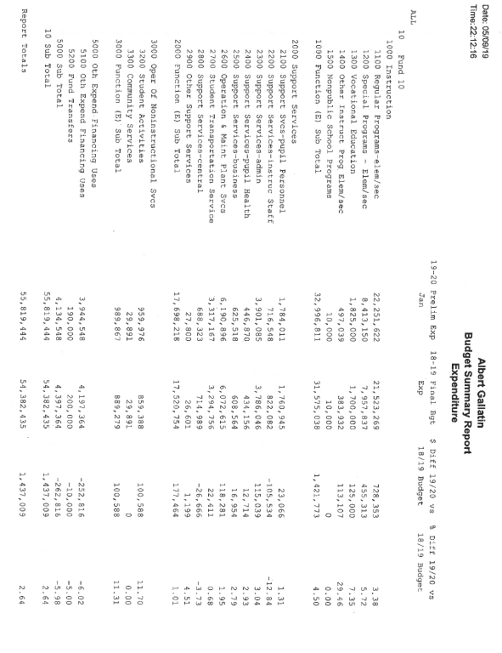
expenditures

Slide 21
Fringe benefits - $15,456,267
Medical - 27.88% - $4,309,220
Dental – 1.37% - $212,004
Rx – Prescription Drug – 7.71% - $1,191,155
Vision – 0.17% - $26,855
Social Security – 10.54% - $1,629,109
Retirement – 47.24% - $7,302,245
Life Insurance – 0.18% - $27,897
Tuition Reimbursement – 0.39% - $60,000
Unemployment Comp – 0.25% - $38,500
Workers’ Comp – 1.24% - $191,665
Retiree Health Insurance – 2.86% - $442,617
Buy-Out Incentives – 0.16% - $25,000
Retirement, medical, social security and prescription drug comprise 93.4% of fringe.

Slide 22
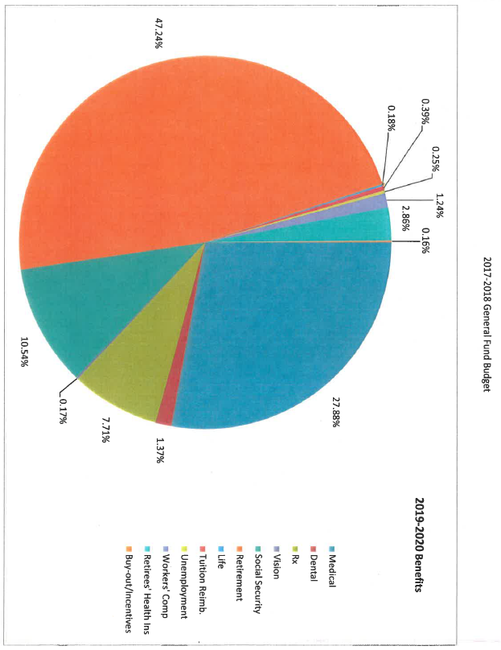
BENEFITS

Slide 23
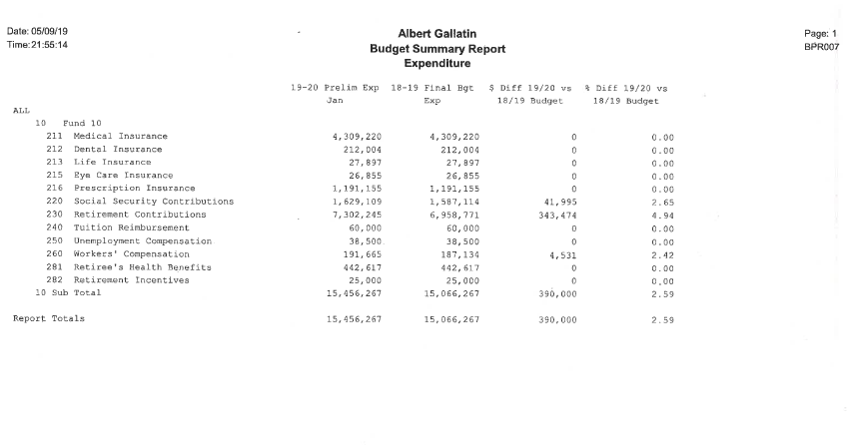
BENEFITS

Slide 24
Retirement - $7,302,245
 | AFR | AFR | Net
Year | Expenitures | Reimbursement | Cost | Rate
 | Obj 230 | 7820
2007-2008 | 1,329,641 | 839,170 | 490,471 | 7.13%
2008-2009 | 926,354 | 640,364 | 285,990 | 4.76%
2009-2010 | 960,651 | 643,452 | 317,199 | 4.78%
2010-2011 | 1,111,194 | 757,339 | 353,855 | 5.64%
2011-2012 | 1,659,845 | 1,077,443 | 582,402 | 8.65%
2012-2013 | 2,409,342 | 1,578,474 | 830,868 | 12.36%
2013-2014 | 3,329,682 | 2,264,521 | 1,065,161 | 16.93%
2014-2015 | 4,256,784 | 2,977,052 | 1,279,732 | 21.40%
2015-2016 | 5,120,524 | 3,540,004 | 1,580,520 | 25.84%
2016-2017 | 5,772,208 | 4,102,126 | 1,670,082 | 30.03%
2017-2018 | 6,389,564 | 4,443,007 | 1,946,557 | 32.57%

Slide 25
Retirement - $7,302,245
The District will spend approximately 34.3 cents per dollar of salary for retirement costs in 2019-20. The District has no control over contributions to the state retirement system. The retirement contribution for the state pension fund for school employees is established by a state agency - PSERS. Retirement costs benefit the employee in the form of future income. The cost increase to the District is based on state law, which stipulates how the District contribution is calculated. Pension costs have risen from 4.76% of payroll in 2008-09 to 33.43% in 2018-19, over 600%! The 2019-20 rate is 34.29% with a rate of 36.30 projected for 2023-24. This retirement cost will increase spending without any salary increase!

Slide 26
Debt service - $4,130,775
Year
 | Total Expense | Total Reimbursement | Net Expense
2019-2020 | 4,130,775.51 | 1,364,761.11 | 2,766,014.40
2020-2021 | 4,084,653.26 | 1,326,853.83 | 2,757,799.43
2021-2022 | 4,050,767.26 | 1,299,093.63 | 2,751,673.63
2022-2023 | 4,013,015.51 | 1,268,292.93 | 2,744,722.58
2023-2024 | 3,969,471.76 | 1,235,894.34 | 2,733,577.42
2024-2025 | 3,928,929.76 | 1,203,470.59 | 2,725,459.17
2025-2026 | 3,249,442.63 | 803,282.38 | 2,446,160.25
2026-2027 | 3,270,537.50 | 255,585.04 | 3,014,952.46
 | 30,697,593.19 | 8,757,233.85 | 21,940,359.34

Slide 27
Debt service - $4,130,775
Debt service will decline slightly over the next eight years; unfortunately reimbursement will also decline, causing our net expense to increase 9% for debt service. Please be advised that even though debt service will end at the end of fiscal 2026-27, the end of bond issues usually indicates time for renovation is near.

Slide 28
Free & reduced lunch
Year
 | Enrollment | Free Lunch | Reduced Lunch | % Free | % Reduced | % Free & Red
2007-2008 | 3777 | 1833 | 373 | 48.53% | 9.88% | 58.41%
2008-2009 | 3808 | 1862 | 401 | 48.90% | 10.53% | 59.43%
2009-2010 | 3727 | 2046 | 387 | 54.90% | 10.38% | 65.28%
2010-2011 | 3657 | 1894 | 308 | 51.79% | 8.42% | 60.21%
2011-2012 | 3647 | 1931 | 288 | 52.95% | 7.90% | 60.84%
2012-2013 | 3514 | 1907 | 258 | 54.27% | 7.34% | 61.61%
2013-2014 | 3586 | 1859 | 231 | 51.84% | 6.44% | 58.28%
2014-2015 | 3501 | 1833 | 210 | 52.36% | 6.00% | 58.35%
2015-2016* | 3442 | 2809 | 0 | 81.61% | 0.00% | 81.61%
2016-2017* | 3429 | 2798 | 0 | 81.60% | 0.00% | 81.60%
2017-2018* | 3298 | 2836 | 0 | 85.99% | 0.00% | 85.99%
*Years the District participated in the Community Eligibility Program
Source: Pennsylvania Department of Education
Teachers & Administrators
Food Nutrition/National School Lunch Program Reports

Slide 29
Free & reduced lunch
The growth of low-income families and those in poverty within our district is further documented by an increase in the free and reduced price lunch program participants and their rising proportion. From 2015-16 we have been accepted into the Community Eligibility Program, which is derived from two factors. First, students that are directly certified for Free Status and second, a percentage given to us by PDE, that factors in students considered free or reduced if we used the application process. Current factor is 1.6%, which is multiplied by the identified students to determine our CEP percentage.

Slide 30
Revenues - $53,340,906
 | Local | State | Federal | Total | Increase
Year | Revenue | Revenue | Revenue | Revenue | (Decrease)
2007-2008 | 10,601,438 | 31,951,797 | 2,281,072 | 44,834,307
2008-2009 | 8,976,267 | 35,516,333 | 2,367,673 | 46,860,273 | 2,025,966
2009-2010 | 9,063,463 | 31,065,008 | 6,793,406 | 46,921,877 | 61,604
2010-2011 | 9,559,719 | 29,819,869 | 8,136,457 | 47,516,045 | 594,168
2011-2012 | 10,474,389 | 32,232,611 | 2,763,933 | 45,470,933 | (2,045,112)
2012-2013 | 10,853,618 | 32,588,505 | 3,397,364 | 46,839,487 | 1,368,554
2013-2014 | 10,730,867 | 33,462,396 | 3,621,789 | 47,815,052 | 975,565
2014-2015 | 11,121,543 | 34,211,262 | 3,145,463 | 48,478,268 | 663,216
2015-2016 | 11,544,292 | 35,528,993 | 2,803,069 | 49,876,354 | 1,398,086
2016-2017 | 12,797,080 | 37,562,155 | 2,505,526 | 52,864,761 | 2,988,407
2017-2018 | 12,976,146 | 37,360,912 | 1,854,757 | 52,191,815 | (672,946)
Source: Pennsylvania Department of Education
Teachers & Administrators / School Finances / Finances
Summaries of AFR Data
Most recent data available as of 4/13/19 (2007-2008 through 2016-2017)
Source for 2017-2018: School District Annual Financial Report

Slide 31
2019-20 Revenues

Slide 32
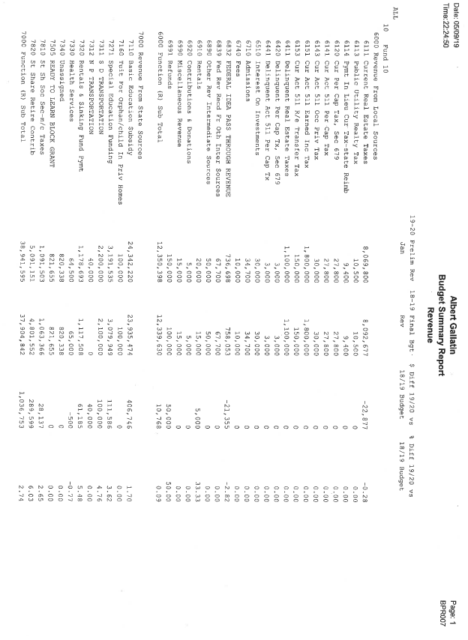
Budget summary report - Revenue

Slide 33
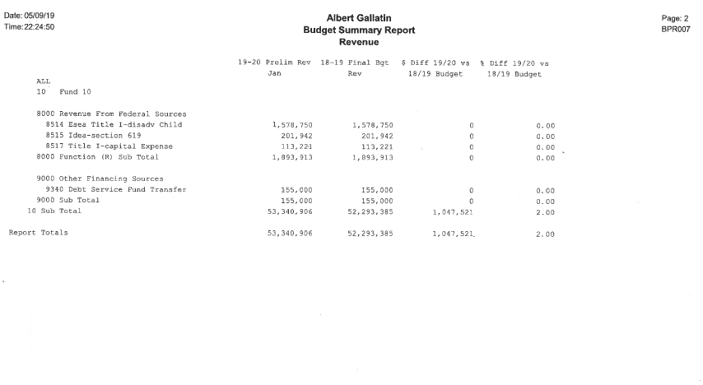
Budget summary report - Revenue

Slide 34
Revenues - $53,340,906
While Pennsylvania recently passed a statewide funding formula to more equitably distribute funds across school districts, the current budget will prevent schools from making important long-term investments to improve student performance and address structural inequalities. Smaller class sizes, more robust early childhood education, teacher development, arts programming and after-school activities in schools are all correlated to better student achievement and student outcomes.
However, Pennsylvania does not currently use an education funding formula that distributes education dollars accurately and fairly! Only new money is distributed on a student-weighted funding formula, which in the 2018-19 fiscal year amounted to only six (6%) per cent of our total basic education funding, or $1,468,329 of our $23,892,465 BEF subsidy.
State revenue continues to comprise the majority revenue source for our District at 71.5%. Local revenue comprises 25% and federal 3.5%.
Our largest revenue component, state revenue, has not been a predictable source of funds with the amounts varying significantly through the years. It took seven years for the District to catch-up to 2008-09 funding levels. Federal revenues are currently at a ten year low of $1,854,757.
The current proportion of compensation to total personal income as the source of both property tax and earned income tax is not conducive to property tax increases for general revenue purposes. Both combine for less than 19% of total revenues and are constrained by action of the State legislature under Act 1 limitations and the statuary cap on the rate of EIT. These tax limits affect the District’s ability to pay higher expenses by increasing revenue from property, which accounts for approximately 15% of total revenues.
Money matters in education and children attending well-resourced schools perform better on achievement tests. However, Pennsylvania’s current education budget still falls far short of what we need to adequately fund our schools!

Slide 35
Millage rates - taxes
 |  |  | MILLAGE RATES
 | ALBERT GALLATIN ASD | BROWNSVILLE ASD | CONNELLSVILLE ASD | FRAZIER SD | LAUREL HIGHLANDS SD | UNIONTOWN ASD |  | AVERAGE
2018-19 | 14.93500 | 18.35140 | 14.24810 | 18.71490 | 17.46800 | 15.60000 |  | 16.55290
2017-18 | 14.93500 | 18.35140 | 14.24810 | 18.71490 | 17.46800 | 15.60000 |  | 16.55290
2016-17 | 14.93500 | 18.35140 | 14.24810 | 18.09960 | 16.75640 | 14.43000 |  | 16.13675
2015-16 | 13.00880 | 17.75400 | 14.24800 | 17.32390 | 16.75640 | 14.43000 |  | 15.58685
2014-15 | 12.48710 | 18.18800 | 12.95280 | 16.14900 | 15.34730 | 14.43000 |  | 14.92570
2013-14 | 12.48710 | 16.32000 | 12.60000 | 15.17700 | 15.34730 | 14.43000 |  | 14.39357
2012-13 | 12.48710 | 16.57000 | 12.60000 | 14.31000 | 15.34730 | 14.43000 |  | 14.29073
2011-12 | 12.48710 | 16.57000 | 12.60000 | 13.33000 | 14.71100 | 14.43000 |  | 14.02135
2010-11 | 11.11900 | 16.57000 | 12.60000 | 13.33000 | 14.21101 | 14.43000 |  | 13.71000
2009-10 | 11.11900 | 13.07000 | 12.60000 | 13.06900 | 13.93236 | 14.43000 |  | 13.03673
 | 130.00020 | 170.09620 | 132.94510 | 158.21830 | 157.34507 | 146.64000 |  | 149.20748
10 Yr %
Increase | 34.32% | 40.41% | 13.08% | 43.20% | 25.38% | 8.11% |  | 26.97%
2018-19 Real Estate Taxes Collected = $8,301,342 @ 14.935 miles = $555,831 per mill
 | Fayette County SD Ten (10) year average |  | 149.20748
 | AGASD 10 (Ten) year actual |  | 130.00020
 | AGASD ten (10) year actual less average |  | 19.20728
 | Value of 19.20728 AGASD mills @ $555,831 / mill |  | $ 10,676,000.72

Slide 36
Millage rates - taxes
The District receives the majority of its local revenue from real estate taxes, raising them three times in ten years. Currently, four of the Fayette County’s six school districts have a higher millage rate than Albert Gallatin.
Looking at a ten-year summary of millage rates, we collected 130 mills as opposed to the countywide average of 149.2 mills. This value of 19.2 mills at our current collection rate is over $10,676,000 of lost revenue or opportunity lost. Remember, this is just maintaining the average millage rate for Fayette County schools!
Since we have an adjusted Act 1 Index, we are relatively poorer than other districts in the state. Our MV/PI aid ratio is 0.7353. As such, since our aid ratio is greater than 0.4000, we get the privilege of adjusting our index upward for greater taxation! The law reads, “For school districts with a market value/personal income aid ratio (MV/PI AR) greater than 0.4000, the value of their index is adjusted upward by multiplying the base index by the sum of 0.75 and their MV/PI AR.” For example, the base index for 2019-20 is 3.4% and our district’s MV/PI AR is 0.7353. AGASD’s adjusted index is 3.4% X (0.75 + 0.7353) = 5.05%.
For comparison, a more affluent (richer) district with an MV/PI AR less than 0.4000 = 3.4%, the base index.
Bottom line, we can tax over 48.5% greater than a district with a MV/PI AR of less than 0.4000!!!
The base index is calculated by averaging the percent increases in the Pennsylvania statewide average weekly wage and the Federal employment cost index for elementary/secondary schools.

Slide 37
Summary of financial conditions
 |  | Tax | Tax
 | No Tax | Increase | Increase
 | Increase | to Index | above Index
06/30/18 Audited Fund Balance | $4,811,780 | $4,811,780 | $4,811,780
18-19 Final Budget Revenues | $52,293,465 | $52,293,465 | $52,293,465
18-19 Final Budget Expenditures | $54,382,435 | $54,382,435 | $54,382,435
Budgeted Decrease to Fund Balance | ($2,088,970) | ($2,088,970) | ($2,088,970)
06/30/19 Estimated Fund Balance | $2,722,810 | $2,722,810 | $2,722,810
19-20 Proposed Final Budget Revenues | $53,340,906 | $53,638,934 | $53,850,377
19-20 Revenue decrease due to furloughs (SS&RET) | ($342,000) | ($342,000) | ($342,000)
19-20 Adjusted Revenues | $52,998,906 | $53,296,934 | $53,508,377
19-20 Proposed Final Budget Expenditures | $55,819,444 | $55,819,444 | $55,819,444
19-20 Intent to furlough & other savings | ($596,490) | ($596,490) | ($596,490)
19-20 Retirements Salary and Fringe Savings (Net) | ($180,000) | ($180,000) | ($180,000)
19-20 Health Consortium Savings (One year only) | ($1,200,000) | ($1,200,000) | ($1,200,000)
19-20 ACSHIC 3 Yr Buy-in 20% Premium | $380,333 | $380,333 | $380,333
18-19 IU1 Health Consortium Buy-out | $534,837 | $534,837 | $534,837
19-20 Proposed Final Budget Expenditures | $54,758,124 | $54,758,124 | $54,758,124
19-20 Decrease to Fund Balance | ($1,759,218) | ($1,461,190) | ($1,249,747)
6/30/20 Est Fund Bal with state increases | $963,592 | $1,261,620 | $1,473,063
Potential tax revenue to be generated | $0 | $298,028 | $509,471
Millage Increase | 0 | 0.5077 | 0.8679
Total Millage Rate | 14.93500 | 15.44270 | 15.80290
Percentage Increase | 0.00% | 3.40% | 5.81%
 |  | Assessed Values
 |  | 50,000 | 100,000
Current Millage | 14.9350 | 746.75 | 1,493.50
Increase up to 3.4% Index | 0.5077 | 25.39 | 50.77
Increase above the 3.4% Index | 0.3602 | 18.02 | 36.03
Total allowable millage increase | 0.8679 | 43.41 | 86.80
Estimated allowable millage rate for 2019-2020 | 15.8029 | 790.16 | 1,580.30
 | 5.81% | 5.81% | 5.81%

Slide 38
Summary of financial conditions
For the current fiscal year 2018-19, $2,088,970 of fund balance was used to balance the budget. Professional salary increases were included into this year’s budget. So we are favorable to budget in this category since we have no settlement with the teachers.
The budget for 2019-20 has expenditures $2,478,538 greater than revenues. With no reductions in labor, programs or other expenses and no tax increase, the fund balance will be basically depleted; less than $250K at the end of 2019-20. This time next year, preparing the 2020-21 budget would result in a deficit of approximately $2.8M or greater. Needless to say, our district could become a financially distressed school district.
I’ve enclosed a five-page review by the Education Law Center explaining the ramifications of the School District Financial Recovery Law – Act 141. We can govern ourselves and must take all necessary measures to get our district back to a balanced budget without using fund balance. I am recommending a tax increase to the total allowable (index + exceptions), proceed with the intent to furlough, make as many reductions to staff through attrition as possible and continue to reduce as many expenses as possible. We need to stop the hemorrhaging now.
I would strongly recommend an 8% fund balance or $4.4 million. Higher aid ratio districts like ours cannot generate the type of real estate taxes that a lower aid ratio district can generate. Under no circumstance should our fund balance fall below 4% or $2.2 million, necessitating a tax increase above the index.
With higher costs and limited dollars, we must cut costs to balance the budget each year. Again, we reduce costs by (a) eliminating certain programs, courses, and reducing other costs and/or (b) reducing the number of teachers, administrators, aides, custodians and secretaries.
The recommendations I have made will create anxiety in the community and among our staff. My major effort is to see that we not only maintain an outstanding school system but that we continue to improve where necessary. I am convinced that in order to do so we must shrink our facilities, and ultimately our staff, if we are to provide a full range of fine programs and services. I am also convinced that we must have an intellectual long-range plan to accomplish this, if we are to avoid the annual attempts to “nickel and dime” our allocations and programs by annual budget cuts.
The amazing thing about Act 141 is that if a Chief Recovery Officer (CRO) is appointed by the Secretary of Education, aside from serving at the pleasure of the Secretary, Act 141 does not specify any oversight or accountability for the CRO. Rather than restore some of the severe education funding cuts from the past, Act 141 only allows school districts in Financial Recovery Status to request loans. Act 141 does not provide for direct financial aid to financially troubled school districts. If the school board fails to maintain the objectives of the recovery plan established by the CRO, the Secretary of Education will petition the court of common pleas for the appointment of a receiver.
A receiver is appointed by the Secretary and approved by the court. By assuming all the powers and duties of the CRO and the school board, the receiver has even more power than the CRO.
Local school districts are destined to either run by themselves or have someone run them appointed by the agency causing the problem!
Thank you and let’s get this done! We can do it!!

Slide 39
The first half of my life was spent in the private sector. VW’s philosophy was posted for employees to subscribe. I believe the philosophy is as appropriate to schools as it is to business, and I have chosen to substitute the word student for customer:
A student is the most important person in any school.
A student is not an interruption of our work – the student is the purpose of it.
A student is not just a statistic. The student is a flesh-and-blood human being with feelings and emotions like ourselves.
A student is one who comes to us with needs and/or wants. It is our job to fill them.
A student is deserving of the most courteous and attentive treatment that we can provide.
A student is the lifeblood of this and every other school. Without students, we would have to close our doors.
“From the desk where I sit, the answer to all world problems is found in a single word. That word is education.”

Slide 40
Questions?

